Slide 1
WORLD OF LASERS
Laser Application: Healthcare

Slide 2
HEALTHCARE
Lasers in eye surgery and vision correction (LASIK).

Slide 3
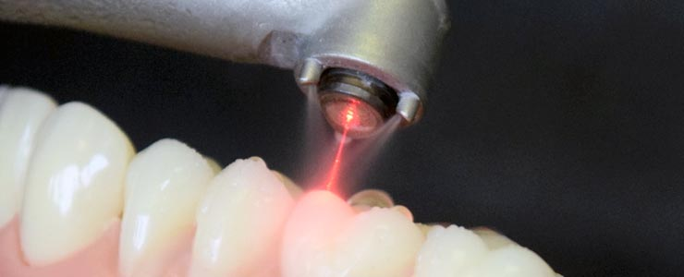
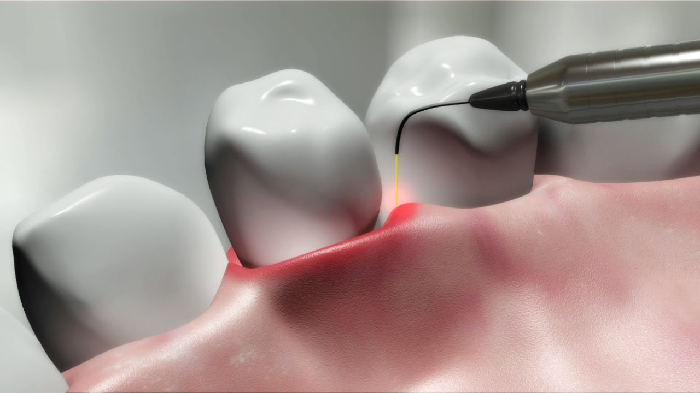
HEALTHCARE
Lasers in dentistry.

Slide 4
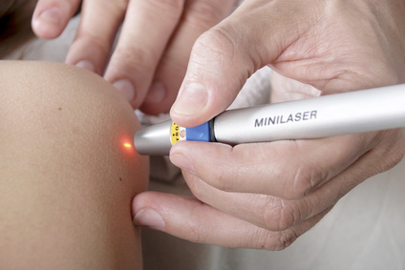
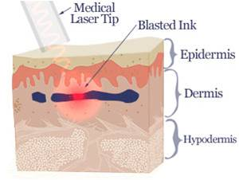
HEALTHCARE
Lasers in dermatology (e.g. photodynamic therapy of cancer), and various kinds of cosmetic treatment such as tattoo removal and hair removal.

Slide 5
?
WELL DONE!
Now you can go deeper into the laser differences relative to ordinary lights
GO TO HOW LASER WORK AREA!

